Slide 1
LEAVE MANAGEMENT SYSTEM
Coapps, Tidel Park, "D"North Block, First Floor,
Rajiv Gandhi Salai, Taramani
Chennai - 600113

Slide 2
INTRODUCTION
This Leave Management System is an Intranet based application that can be accessed throughout the organization or a specified group or department
This system can be used to automate the workflow of leave applications and their approvals
There are features like cancellation of leave, approval of leave, and so on.
The project has been planned to be having with centralized form of storing the database.

Slide 3
OBJECTIVES
To improve security
To properly coordinate between different users
Reduce mismanagement
To provide user-friendly interface

Slide 4
MODULES
The modules involved are:
1] Administration( Main admin)
2] Staff

Slide 5
MODULE 1
Admin can add a Staff and also update the Staff information.
Admin can also manage the leave application (approve/not approve).
Whenever a Staff applies for leave admin will get a notification.
Admin can change own password after login.
Admin can also view admin dashboard.

Slide 6
MODULE 2
The Staff can log in with entering valid login credentials - email and password.
Update their profile
Apply for leave
View their leave history
Change their old password

Slide 7
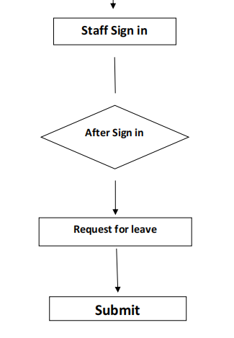
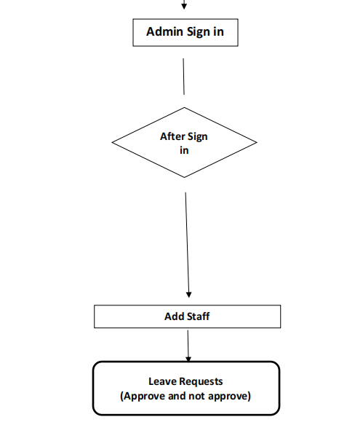
FLOWCHARTS

Slide 8
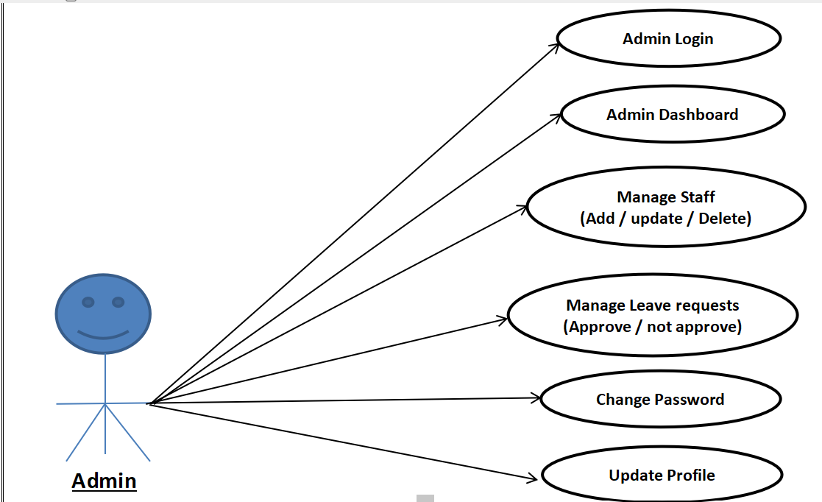
ADMIN - USE CASE DIAGRAM
Admin

Slide 9
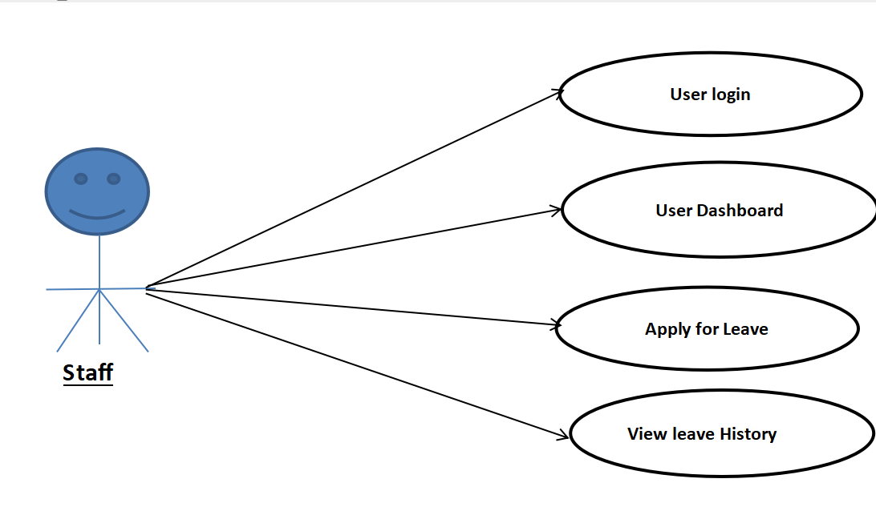
STAFF - USE CASE DIAGRAM
Staff

Slide 10
SOFTWARE REQUIREMENTS
Programming Language Used: Python
Framework Used: Django
Database: SQLite
User Interface Design: HTML, AJAX,JQUERY,JAVASCRIPT
Web Browser: Mozilla, Google Chrome, etc.
IDE Used: PyCharm

Slide 11
IDEA
The project has been planned to be having the view of distributed architecture, with centralized storage of the database.
All the user interfaces have been designed using the Python technologies and using Django framework.
The database connectivity is planned using the “SQLite” methodology.

Slide 12
Designing user interfaces
User Interface Design done by: HTML, CSS, JQUERY,JAVASCRIPT

Slide 13
HTML and CSS
HTML (Hypertext Markup Language) and CSS (Cascading Style Sheets) are two different languages that are used together to create web pages. HTML defines the content and structure of a page, while CSS controls the page's presentation and layout.

Slide 14
Javascript , Jquery and AJAX
JavaScript is client-side, i.e., in the browser scripting language, whereas jQuery is a library or framework built with JavaScript. Meanwhile, AJAX is a method to immediately update parts of the UI without reloading the web pages.

Slide 15
Uses of the technologies
Creating a staff leave management system using Python with Django involves integrating HTML, CSS, JavaScript, jQuery, and AJAX to build a responsive and interactive user interface.
HTML will be used to structure the various components of the web application, such as forms for submitting leave requests, tables for displaying leave history, and navigation menus.
CSS will be used to style the HTML elements, ensuring a visually appealing and consistent layout across different devices. You can customize the appearance of buttons, forms, tables, and other UI elements to match the design requirements of your leave management system.
JavaScript will be used to add interactivity to the application, such as form validation, dynamic updates to the UI, and handling user interactions. For example, you can use JavaScript to validate leave request forms before submission and provide real-time feedback to users.
jQuery is a JavaScript library that simplifies DOM manipulation and event handling. You can use jQuery to perform common tasks such as selecting DOM elements, handling user events, and making AJAX requests. For instance, you can use jQuery to asynchronously load leave requests from the server and update the UI without refreshing the entire page.
AJAX allows you to send and receive data from the server without reloading the entire web page. You can use AJAX to implement features such as submitting leave requests, updating leave status, and fetching leave history from the server in the background. This provides a more seamless user experience by avoiding page reloads and reducing latency.

Slide 16
Database: SQLite INTRODUCTION
SQLite is a C-language library that implements a small, fast, self-contained, high-reliability, full-featured, SQL database engine.
SQLite is the most used database engine in the world.
SQLite database files are commonly used as containers to transfer rich content between systems and as a long-term archival format for data.
SQLite source code is in the public-domain and is free to everyone to use for any purpose.

Slide 17
Database: SQLite
This Leave Management System (LMS) contains 3 SQLite tables :
admin
Staffs
Staff leaves

Slide 18
Database: SQLite
Name | Type
password | CharField(max_length=128)
last_login | DateTimeField(blank=True, null=True)
is_superuser | BooleanField()
username | CharField(unique=True, max_length=150)
first_name | CharField(max_length=150)
last_name | CharField(max_length=150)
email | CharField(max_length=150)
is_staff | BooleanField()
is_active | BooleanField()
date_joined | DateTimeField()
user_type | CharField(max_length=50)
profile_pic | CharField(max_length=100)
1] admin

Slide 19
Database: SQLite
Name | Type
password | CharField(max_length=128)
last_login | DateTimeField(blank=True, null=True)
is_superuser | BooleanField()
username | CharField(unique=True, max_length=150)
first_name | CharField(max_length=150)
last_name | CharField(max_length=150)
email | CharField(max_length=150)
is_staff | BooleanField()
is_active | BooleanField()
date_joined | DateTimeField()
CharField(max_length=100) | CharField(max_length=100)
user_type | CharField(max_length=50)
profile_pic | CharField(max_length=100)
address | TextField()
gender | CharField(max_length=100)
created_at | DateTimeField()
updated_at | DateTimeField()
2] staffs

Slide 20
Database: SQLite
Name | Type
leave_type | CharField(max_length=100)
from_date | CharField(max_length=100)
to_date | CharField(max_length=100)
message | TextField()
status | IntegerField()
created_at | DateTimeField()
updated_at | DateTimeField()
staff_id | ForeignKey(SlmsappStaff, models.DO_NOTHING)
3] Staff leaves

Slide 21
INTRODUCTION TO PYTHON
What can Python do?
Python can be used on a server to create web applications.
Python can be used alongside software to create workflows.
Python can connect to database systems. It can also read and modify files.
Python can be used to handle big data and perform complex mathematics.
Django is a web application framework written in Python programming language. It is based on MVT (Model View Template) design pattern.
It takes less time to build application after collecting client requirement.

Slide 22
INTRODUCTION TO DJANGO
Django is a web application framework written in Python programming language.
It takes less time to build application after collecting client requirement.
Django is a Python framework that makes it easier to create web sites using Python.
Django takes care of the difficult tasks so that you can concentrate on building your web applications.
Django is especially helpful for database driven websites.

Slide 23
BASIC WORKING OF DJANGO
Django follows the MVT design pattern (Model View Template).
Model - The data you want to present, usually data from a database.
View - A request handler that returns the relevant template and content - based on the request from the user.
Template - A text file (like an HTML file) containing the layout of the web page, with logic on how to display the data.

Slide 24
IMPLEMENTATION OF DJANGO
Steps To implement the staff leave management system in Python with Django:
Set up Django Project: Create a new Django project and define models to represent staff members, leave requests, and other relevant data.
Create Views and Templates: Define views to handle HTTP requests and render HTML templates. Use Django's template engine to generate dynamic HTML content with data from the database.
Design UI with HTML and CSS: Create HTML templates to define the structure of the web pages and use CSS to style the UI elements according to your design specifications.
Add Interactivity with JavaScript and jQuery: Write JavaScript code to add interactivity to the UI, such as form validation and handling user interactions. Utilize jQuery to simplify DOM manipulation and AJAX requests. DOM manipulation refers to the process of accessing, modifying, or updating the Document Object Model (DOM) of a web page using JavaScript or other scripting languages
Implement AJAX Endpoints: Define Django views to handle AJAX requests from the client-side JavaScript code. These views should perform operations such as saving leave requests to the database and fetching leave history for display.
Test and Debug: Test the application to ensure that it functions correctly and fix any bugs or issues that arise during testing.
Deploy the Application: Deploy the staff leave management system to a production environment, ensuring that it is accessible to staff members and meets performance and security requirements.

Slide 25
DJANGO CLASSES USED
1. `AuthGroup`: Represents a group that can have permissions assigned to it. 2. `AuthGroupPermissions`: Represents the relationship between groups and permissions. 3. `AuthPermission`: Represents a permission, which can be assigned to groups or users. 4. `DjangoAdminLog`: Represents logs of administrative actions performed via Django's admin interface. 5. `DjangoContentType`: Represents content types used by the Django admin. 6. `DjangoMigrations`: Keeps track of database schema migrations. 7. `DjangoSession`: Stores session data for users. 8. `SlmsappCustomuser`: Represents custom users in the application. 9. `SlmsappCustomuserGroups`: Represents the relationship between custom users and groups. 10. `SlmsappCustomuserUserPermissions`: Represents the relationship between custom users and permissions. 11. `SlmsappStaff`: Represents staff members, possibly associated with custom users. 12. `SlmsappStaffLeave`: Represents leave requests made by staff members.

Slide 26
TEAM MEMBERS: DHARSHINI M DHIVINKUMAR A J ARUNKUMAR K J
THANK YOU FOR THE OPPORTUNITY

